Slide 1
Как защитить банк и деньги клиентов от целевых атак
Владимир Илибман
Эксперт Cisco по информационной безопасности
voilibma@cisco.com

Slide 2
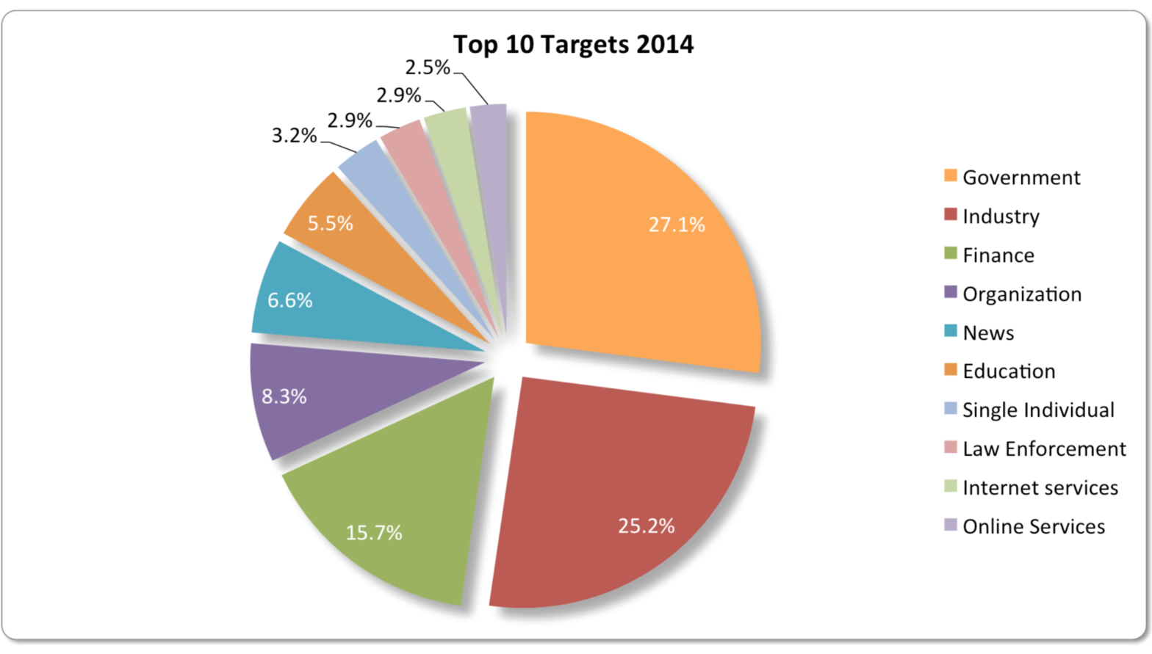
Тренды атак по разным вертикальным сегментам
Более 15% всех атак нацелены на финансовый сектор
Атаки включают:
  DDoS
  Шпионское ПО/банковские трояны
  Атаки на клиент-банк и системы ДБО
  Атаки на мобильные устройства
  Взломы веб-сайтов
  Кардинг
Source : IDC ™
Notes:
The past several years have been challenging for the financial services industry. While the vast majority of the industry has stabilized, significant challenges and opportunities remain across the sector. Paramount among these is the search for revenue growth. Whether considering Insurance, Retail Banking or Financial Markets, the common denominator is the impact the crisis and subsequent regulatory and business model changes have had on profitability.
As financial institutions move towards digitization and adopt new ways of supporting customer transactions, the “attack surface” grows in size, and professional hackers adopt new forms of attacks, moving away from Distributed Denial of Service waged as a mode of distraction, to adopt more lucrative threats: spear-fishing, ransomware, massive data theft, and, of course, mobile malware to name but a few. According to the 2014 Verizon Data Breach Report, out of 1367 reported security incidents with confirmed data loss, 465 (over 34%!) were targeted at the Finance industry. IDC state that over 15% of the identified threats target financial institutions. This makes the Finance sector one of the most targeted and impacted, demonstrating that it is indeed an attractive target for cyber criminals.

Slide 3











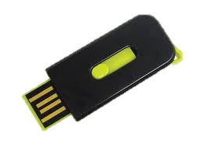





















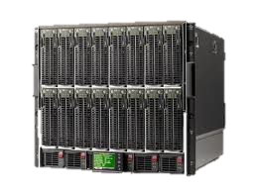










Эволюция кибернападения
?
Целевые
атаки
SPYWARE /
ROOTKITS
WORMS
HACKERS
MACRO
VIRUSES
VIRUSES
1985
1995
2000
2005
2010
2015
Соревнование кибернападения и киберзащиты
приводит к развитию сложности атак
Notes:
AS VENDORS DEVELOPED SOLUTIONS, THE ATTACKERS CONTINUED TO INNOVATE…..
WE SAW MACRO VIRUSES, WORMS, ROOTKITS
AND WE’VE NOW EVOLVED TO VERY SOPHISTICATED MALWARE AND APT’S, IT’S GOTTEN TO THE POINT THAT HACKING HAS BECOME INDUSTRIALIZED.
THERE IS A VERY, VIBRANT SHADOW INDUSTRY THAT IS OUTPACING THE INFORMATION SECURITY INDUSTRY IN TERMS OF REVENUE GENERATION….BUT PROFIT IS NOT THE ONLY DRIVER IN THE HACKING INDUSTRY, NATION STATES ARE BECOMING MAIN ACTORS IN DEVELOPING EXPLOITS FOR CYBERWARFARE AND ESPIONAGE.
~~~~~~~~~~~~~~~~~~~~~~~~~~~~~~~~~~~~~~~~~~~~
Optional:
THE GOOD NEWS IS THAT FOR ALL OF US, WE’RE IN A GREAT INDUSTRY WITH JOB SECURITY
THE BAD NEWS IS THAT WE, THE DEFENDERS, ARE AT A SEVERE DISADVANTAGE.

Slide 4
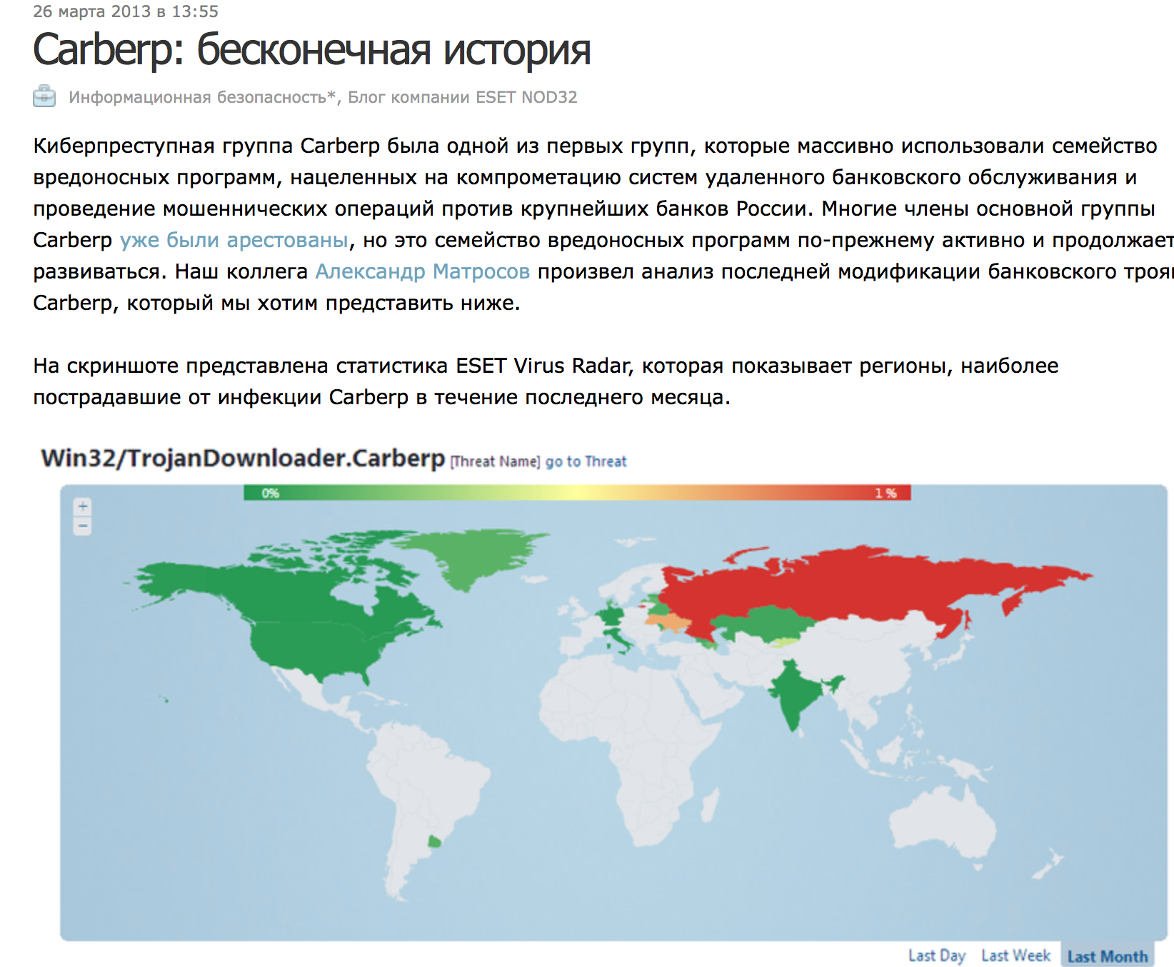
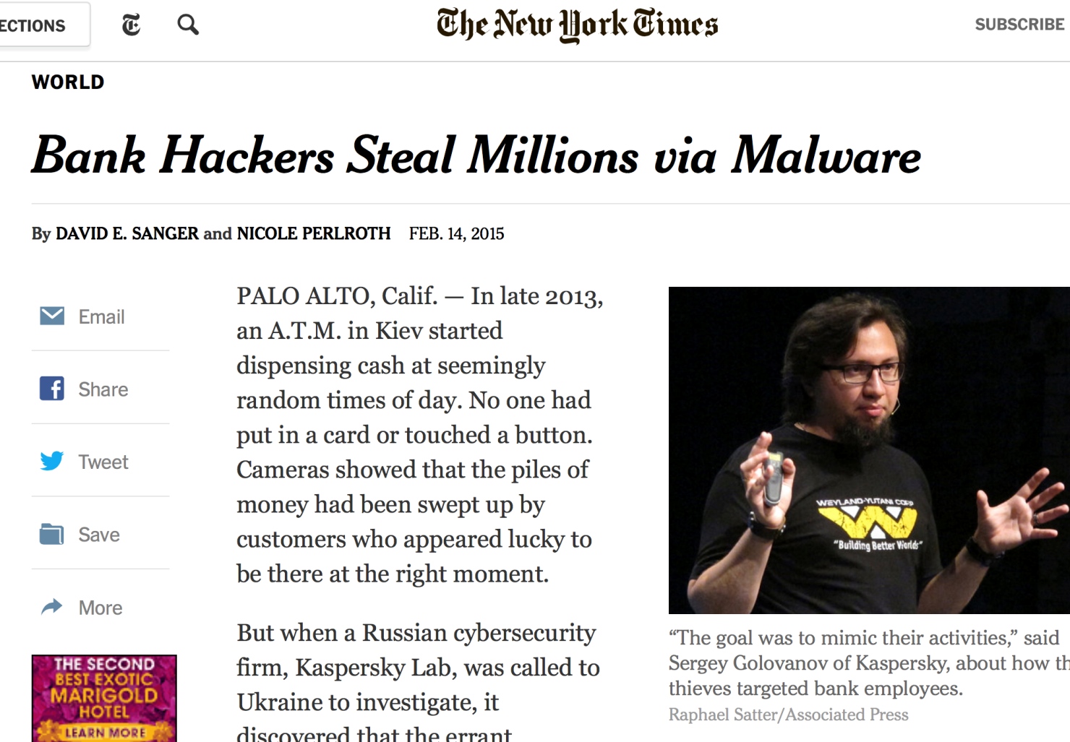
Примеры целевых банковских атак - Carbanak
Notes:
Carbanak – пострадало более сотни банков
2 года
Средняя сумма потери 10M
Примеры атак

Slide 5


Анатомия современной целевой атаки
(Advanced Persistent Threat)
ФИНАНСОВАЯ ОРГАНИЗАЦИЯ
Интернет и облака
ПОЛЬЗОВАТЕЛИ
УЯЗВИМЫЕ ПОЛЬЗОВАТЕЛИ
ПЕРИМЕТР
ЦОД/ Core Systems
Атака проходит на самое слабое звено после тщательной разведки
Продвинутые атаки обходят средства защиты периметра и антивирусы
Атака распространяется по сети и захватывает как можно больше данных
Notes:
1 Этап – социальная инженерия и уязвимость средств защиты
2 этап - отсутствие сегментации сети (в частности пользоват сегмента(

Slide 6
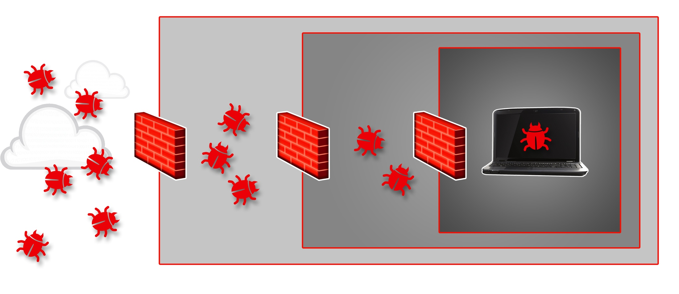
Симптом: Malware на устройстве
Защита в реальной жизни
Защита периметра
Защита сети
Защита устройств
Устройство
Несмотря на все уровни защиты
1) Всегда остается риск проникновения
2) Выявление взлома происходит с запаздыванием
3) Зачастую организации не знают о факте взлома
Notes:
Our assertion, based on experience is that layers of defense are important, but they aren’t foolproof and therefore aren’t sufficient to battling advance malware.
Each layer will catch some - older technologies like Firewalls and AV products do their part. Recently there has been interest in newer approaches like sandbox execution, C&C communication detection and prevalence techniques, that do catch more than older approaches, but still suffer from the same key deficiency as the older approaches – they can be circumvented by a motivated malware writer. As these defense techniques become more prevalent, the malware writers will become more adept at evading them.
Inevitably, some threat will penetrate all layers of defense. Then what?

Slide 7
Точечное выявление атак не может быть эффективно на 100%
Будет поймано Но
99% 1%
угроз приведет ко взлому
Notes:
Мы живем в неидеальном мире – не существует идеальной системы защиты
Всегда сущствует остаточный риск

Slide 8
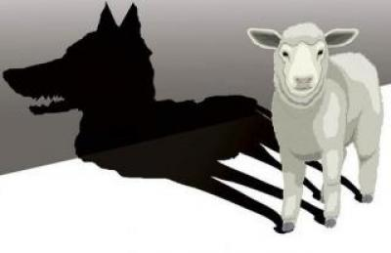

Точечные системы защиты ограничены во времени и ресурсах
Отсутствие видимости после события
Анализ в определенный момент времени
Антивирус
Система
выявления
атак
Момент события
Новый вирус
Маскировка
Устаревший AV
Нехватка ресурсов
Первоначальное предположение:
“Файл чистый”
На самом деле:
“Файл заражен”
Но уже поздно
Notes:
Средства защиты, которые работают в реальном масштабе времени, здесь и сейчас всегда имеют ограниченную точность срабатывания

Slide 9
Киберзлоумышленники действуют оперативно и скрытно
100%
организаций подключаются
к доменам, содержащим
вредоносные файлы
или службы**
54%
взломов
остаются
незамеченными
месяцами*
60%
данных похищается за несколько часов*
*Verizon 2015 Data Breach Investigations Report (DBIR)
* Анализ Cisco DNS запросов за 2014 год
Notes:
On the Internet, malicious activity is no longer usually the work of lone individuals. Criminals are now often part of communities that are continually trying new techniques, trade intellectual property, and sometimes works together.
Most importantly, the speed and frequency of attacks have accelerated. And it can take months or years for victims to discover they’ve been breached. To be truly effective, your defenses must respond in real-time to detect and respond to attacks.
Finally, every organization directly encounters malicious content or actors. While most interactions do not result in harm, your adversaries have many opportunities to cause damage to your company’s resources and reputation.

Slide 10

Новое измерение безопасности
- время реагирования
Устранение уязвимости
*
Обнаружение
*
CRISIS REGION
Кража критичных данных
КРИЗИС
Стоимость инцидента
*
ВЫИГРАННОЕ ВРЕМЯ
*
*
Пресечение
Обнаружение
*
Начало атаки
Оповещение
*
Устранение уязвимости
*
Время
Задача: выиграть время и устранить причину
Notes:
Как мы можем помочь этим компаниям?

Slide 11
Задача ИБ сегодня – не допустить взлома
Новый подход– быстро выявить и устранить взлом
Временная шкала атаки
ДО
ВО ВРЕМЯ
ПОСЛЕ
Контроль
Применение
Усиление
Обнаружение
Блокирование
Защита
Видимость
Сдерживание
Устранение
Выявление атак
Выявление
аномалий
Анализ вред.
кода и трафика
Анализ активов
Оценка рисков
Анализ
уязвимостей
Внедрение
средств защиты
Выявление
скрыт инцидентов
Блокировка атак
Сбор событий
Оценка
остаточного риска
Страхование
рисков
Донастройка
системы защиты
Анализ
инцидентов
Сбор улик
Видимость и контекст
Notes:
LET’S COMPARE HOW TODAY’S TECHNOLOGIES MAP TO THE ATTACK CONTINUUM
WHAT IS INTERESTING IS THAT YOU FIND THAT SPECIFIC TECHNOLOGIES ADDRESS A SPECFIC PHASE OF THE CONTINUUM.
OUR GOAL IS TO BRING INNOVATIVE TECHNOLOGIES, PRODUCTS AND SOLUTIONS TO COVER THE ENTIRE ATTACK CONTINUUM, ACROSS ALL POTENTIAL ATTACK VECTORS, AND WITH TECHNOLOGIES THAT OPERATE, NOT ONLY AT A POINT IN TIME, BUT ALSO HAVE A CONTINUOUS CAPABILITY AND CAN AUTOMATE STEPS IN THE PROCESS.
AND ALL OF THIS NEEDS TO BE BASED ON A FOUNDATION OF VISIBILITY AND CONTEXT. THE MORE YOU CAN SEE AND PLACE INTO CONTEXT, THE MORE YOU CAN UNDERSTAND AND PROTECT.
IT IS OUR AWARENESS TECHNOLOGIES AND INTEGRATION WITH THE NETWORK FABRIC THAT ENABLE US TO SEE MORE SO WE CAN PROTECT MORE.
WE CAN ADDRESS THE FULL ATTACK CONTINUUM TO PROVIDE THE BEST SECURITY SOLUTIONS IN THE MARKET.

Slide 12

Коллективная система защиты Cisco Talos
Big Data на службе информационной безопасности
1001 1101 1110011 0110011 101000 0110 00
1001 1101 1110011 0110011 101000 0110 00
101000 0110 00 0111000 111010011 101 1100001 110
101000 0110 00 0111000 111010011 101 1100001
1100001110001110 1001 1101 1110011 0110011 101000 0110 00
1100001110001110 1001 1101 1110011 0110011 10100
WWW
Automatic Updates
every 3-5 minutes
Email
Endpoints
Web
Networks
IPS
Devices
  100 TB данных в день
  1.6M сенсоров
  150 миллионов устройств
  35% электронной почты
  13B веб-запросов
  Open Source сообщества
  180,000+ файлов в день
  1B запросов в день
  3.6PBytes через облачные системы
  600+ исследователей
  Ранняя информация об угрозах
  Динамический анализ угроз
  Информирование клиентов и партнеров
AMP
Advanced Malware Protection
Notes:
Cisco Advanced Malware Protection, or AMP, is built on unmatched collective security intelligence. This intelligence is collected from Cisco’s Security Intelligence Operations and the Sourcefire Vulnerabiity Research team and then pushed from the cloud to the AMP client so that the user always has the latest threat intelligence.
The intelligence available here is pretty impressive: On one hand you have Cisco’s Security Intelligence Operations that monitors 35% of worldwide email traffic and scans 100 terabytes of data per day in order to build a base of security intelligence. And on the other hand, you have Sourcefire’s Vulnerability Research team that evaluates 180.000 file samples per day and leverages the collective intelligence of the FireAMP, Snort and ClamAV Open source communities. This makes for an AMP solution that is truly built on big data.

Slide 13
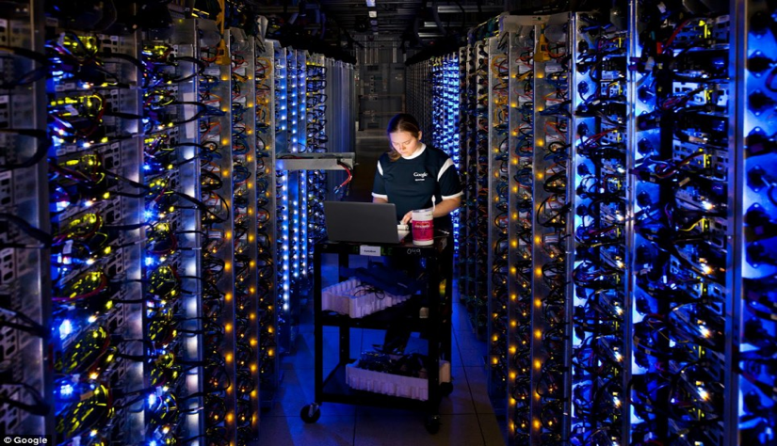
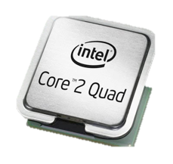
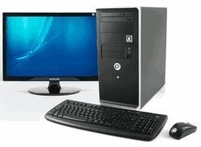
Почему облако ?
Никогда не забывать!
Мощности в петафлопах
Объем в терабайтах и петабайтах
Аналитика больших данных
Постоянный анализ подозрительных элементов в облаке
Элементы искусственного интеллекта
vs

Slide 14
Облачный анализ позволяет безопасности заглянуть в прошлое
Анализ остановлен
Точечное обнаружение
Не 100%
Антивирус
Песочница
Новый вирус
Маскировка
Устаревший AV
Нехватка ресурсов
Пропущеные атаки
Начальное значение = Чисто
Актуальное значение = Плохо = Поздно!!
Анализ продолжается
Регулярный возврат к ретроспективе
Видимость и контроль
AMP
Начальное значение = Чисто
Актуальное значение = Плохо = Блокировано!

Slide 15


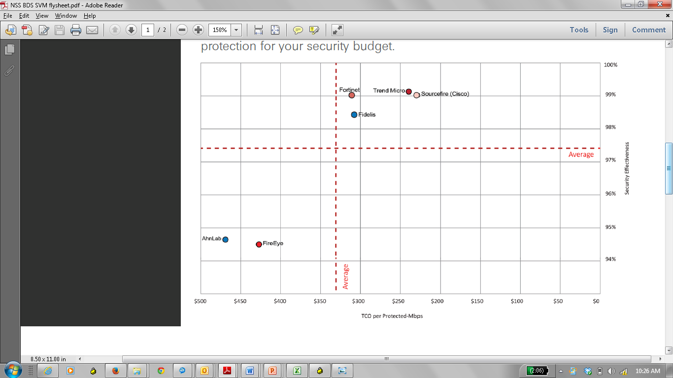




Тесты Cisco Advanced Malware Protection (AMP) - соотношение эффективности и цены
AMP
Security Value Map for
Breach Detection
Protection
Price per Protected Mbps

Slide 16
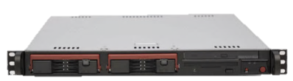

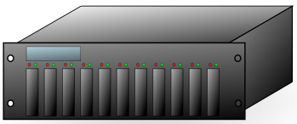
Доверяем ли мы внешнему облаку?
Полностью публичное облако
Гибридное облако (только агрегированные запросы)
Полностью частное облако
(все данные у заказчика)
Cloud Delivered
Data Feed
+
Весь анализ
в облаке
(ThreatGRID)
+
Cloud Delivered
Data Feed
+
Предвар. Анализ хешей в облаке
+
Cloud Delivered
Data Feed
+
AMP Appliance or SW
annual subscription
AMP Appliance или SW
Ежегодная подписка
+
AMP Appliance или SW
Ежегодная подписка
+
НЕТ устройств ThreatGRID
ThreatGRID
Требуется лицензия на ПО
ThreatGRID
Требуется лицензия на ПО
Notes:
ThreatGRID adds deployment flexibility for our AMP customers. With out ThreatGRID, customers must deploy a full cloud-based implementation of Dynamic Analysis. With ThreatGRID customers will benefit from additional deployment options including a hybrid and full on-premises approach.
ThreatGRID's customers submit unknown files to ThreatGRID for analysis, either manually or automatically. The files are submitted either to ThreatGRID's cloud-based offering or the on-premises appliance, depending on how the customer engages with ThreatGRID. ThreatGRID dynamically and statically analyzes the files, and correlates the results with hundreds of millions of other analyzed malware artifacts. Within minutes, ThreatGRID provides a detailed report identifying key indicators along with a threat score, enabling customers to recover from advanced attacks effectively.

Slide 17
Опыт реализованных проектов:
Финансовые организации выбирают Talos и AMP чтобы уменьшить остаточный риск ВЗЛОМА или ОБХОДА существующих систем защиты
Значительное уменьшение ВРЕМЯ ОБНАРУЖЕНИЯ новых типов атак и вредоносного кода (2-10 раз)
Автоматизация разбора полетов ПОСЛЕ АТАКИ уменьшает операционные затраты
First Financial Bank: https://www.youtube.com/watch?v=iqr0ZkTE-R4

Slide 18

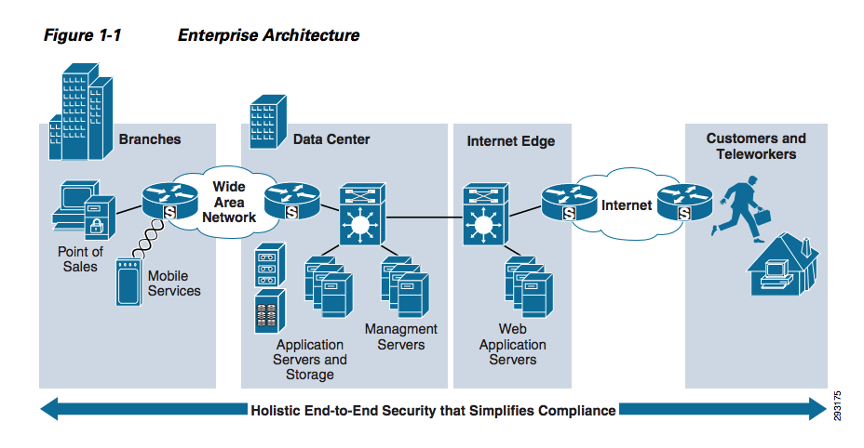
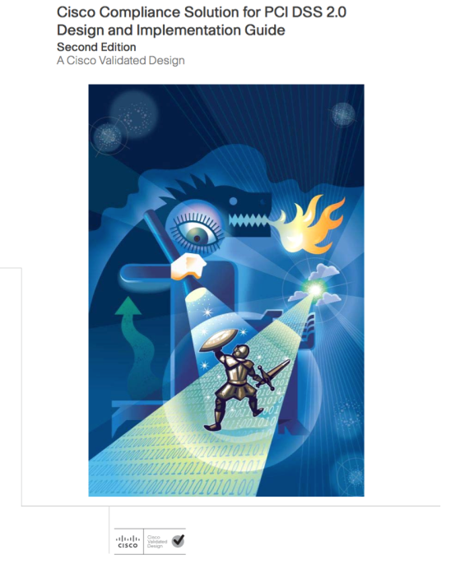
Часть комплексного решения PCI DSS
Notes:
The Payment Card Industry Data Security Standard (PCI DSS) is a proprietary information security standard for organizations that handle branded credit cards from the major card brands including Visa, MasterCard, American Express, Discover, and JCB. The Payment Card Industry Data Security Standard (PCI DSS) was developed to encourage and enhance cardholder data security, and facilitate the broad adoption of consistent data security measures globally. PCI DSS provides a baseline of technical and operational requirements designed to protect cardholder data. PCI DSS applies to all entities involved in payment card processing including merchants, processors, acquirers, issuers, and service providers, as well as all other entities that store, process or transmit cardholder data (CHD) and/or sensitive authentication data (SAD). In other words, the standard is relevant to any organisation which accepts payment by credit card, regardless of the market segment, and to any organisation which provides credit card payment services : banks, credit organisations, clearing houses etc.
The PCI Data Security Standard specifies 12 requirements for compliance, organized into six logically related groups called "control objectives". Each version of PCI DSS has divided these 12 requirements into a number of sub-requirements differently, but the 12 high level requirements have not changed since the inception of the standard. PCI DSS is currently in its third version.
Control objectives are technical (“Build and maintain a secure Network and Systems”, “Implement strong access control measures”), or governance-related (“Maintain an information security policy” , “Maintain a vulnerability management program”, “Maintain an Information Security Policy”), or generic (“Protect Cardholder Data”).
PCI DSS is not an official state-sponsored standard, but it is enforced by the credit card organisations, mainly because higher transaction fees are put in place for those companies who do not comply. There is thus a strong financial incentive for retail merchants and financial bodies to comply.
PCI DSS does have a number of advantages over other attempts at defining standards for the financial communities:
It is based on “common sense”: a lot of the requirements are what the security specialists would qualify as basic IT “hygiene”
A formal compliance checking process has been defined, with approved auditors who can vouch for an organisation’s compliance, both from a technical and a governance perspective.
It is comprehensive, but not overly complex, which makes it’s implementation and adoption reasonable.
Nevertheless, organisations should not assume that being PCI compliance makes them 100% secure. At the time of the breach, Heartland Payment Systems had been audited and was PCI DSS compliant. A compliance audit validates an organisation’s security level at a point in time, not over time. It is thus more important for financial organisations to focus on being secure over time, which will help them to meet compliance requirements, rather than focus on the compliance tests themselves, which will in no way make them secure!
PCI DSS is and remains a very good conversation opener, as Cisco offers a portfolio of services to define the relevant policies and turn them into processes, as well as the architected solutions to support these policies.

Slide 19
Будьте в безопасности!

