Slide 1
e-Government architecture:
a holistic approach & lessons learned …
Peter Reichstädter, CIO
Austrian Parliament / Parliamentary Administration – IT
peter.reichstaedter@parlament.gv.at

Slide 2
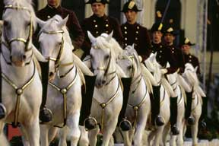
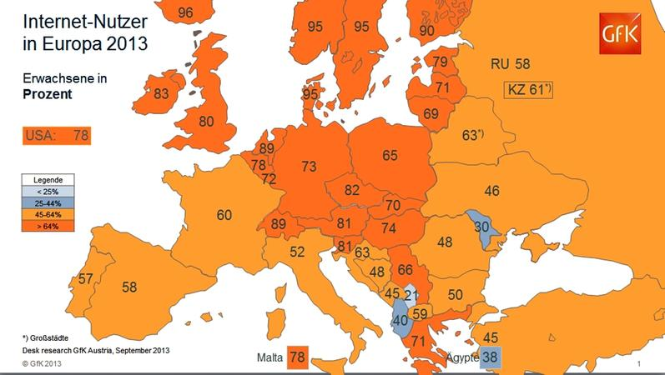



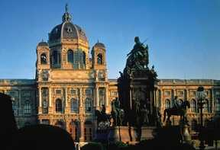
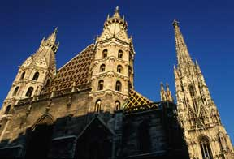

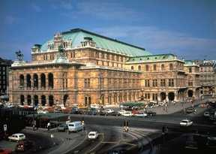

Federal Republic of Austria
Area: 83 879 km² - Population: 8,5 Mio
13 federal ministries - 9 provinces
80 district administrations - 2102 municipalities
Notes:
Austria is situated in Central Europe. Austria’s geographical position has long made it a crossroads for trade routes between the major European economic and cultural areas. Austria borders eight countries: Germany, the Czech Republic, Slovakia, Hungary, Slovenia, Italy, Switzerland and Lichtenstein. Except for the last two, all these countries are part of the European Union.

Slide 3
Architecture - who needs it?!
Why don’t we build our houses / appartments without (architectural) talks & plannings?
assets - or how to map business requirements to ICT capacities?
ReInvent the wheel – how about you?! Are you special?
SILO + Islands =?
              SILENCE ☺
3
Notes:
3

Slide 4
„E-Government it‘s a journey
not a destination!“
Change Management – political will to change – organization + legal
G2G
@
eID, eSig, Security
Marketing, eSkills
G2B
G2C
target oriented portals – live situations – user language

Slide 5

Food for thought …
30% Computer / Server
Software / Technical
70% Leadership,
Organisation,
Access,
Learning,
Support,
Security,
Re-Engineering of
Business Processes
Architecture
…
CC BY-SA 3.: old wiksource logo

Slide 6
e-Gov Integration…
National
IT-Business
State
Districts
vertical architecture
Cities/
Communities
Citizens
horizontal architecture
Portals

Slide 7
Service: ['s&r-v&s]
1: the occupation or function of serving
2: the work performed by one that serves
“It is not the strongest of the species that survive,
nor the most intelligent,
but the ones most responsive to change”
  Charles Darwin

Slide 8


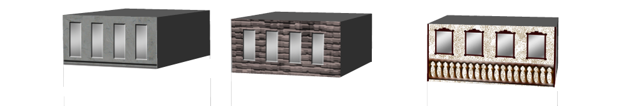
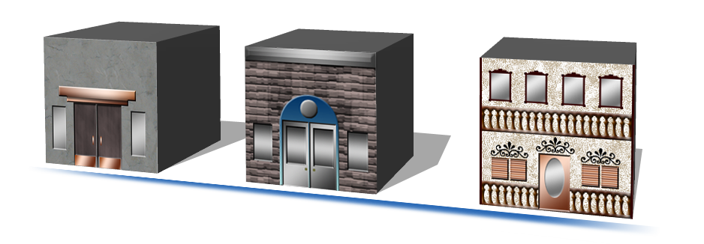
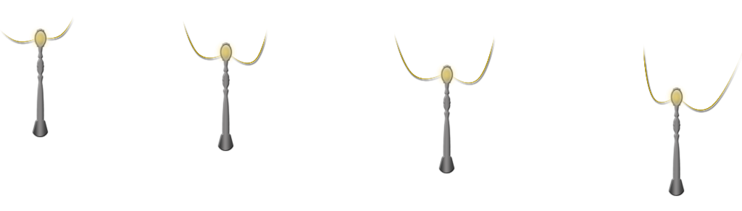


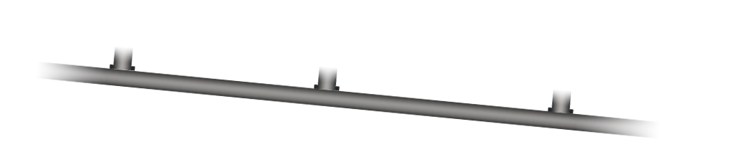





How Cities Evolve

Slide 9

Motivation to use
Enterprise Architecture
Support a business by providing the fundamental technology and process structure for an IT strategy
Achieve the right balance between IT efficiency and business innovation
Allow individual business units to innovate safely in their pursuit of competitive advantage
Assure the needs of the organization for an
integrated IT strategy, permitting possible synergies across organisations
TOGAF 8:
http://pubs.opengroup.org/architecture/togaf8-doc/arch/
Notes:
(TOGAF http://www.opengroup.org/architecture/togaf8-doc/arch/)
Different frameworks emerged over the past ~20 years to support the development of an Enterprise Architecture
Zachman framework: 1984
ARIS reference model: early 1990s
ADONIS reference model: mid 1990s
TOGAF (The Open Group Architecture Framework): 1995
DoDAF (Department of Defense Architecture Framework): 1996
FEAF (Federated Enterprise Architecture Framework): 1999
xGEA (cross-Government Enterprise Architecture as a fundamental element of the government’s “Transformational Government – Enabled by Technology” strategy): 2005

Slide 10
Architecture principles: Definition
According to TOGAF, architecture principles define:
“the underlying general rules and guidelines for the use and deployment of all IT resources and assets across the enterprise”
  http://www.opengroup.org/architecture/togaf8-doc/arch/chap29.html
10
Notes:
10

Slide 11
Architectural Views
Service-Oriented Architecture
Conceptual View
Logical View
Physical View
Business Models
Application Models
Technology Models
Business Analysis
Software
Architecture
Design Implementation

Slide 12
Benefits of considering EA
Better understand the added value of structured
development, support, and maintenance of IT landscape in an organization and in the network with other organizations
  And acquire the respective skills to apply this concept
Improve understanding and learn how to manage interoperability
Understand and learn how to facilitate system and network management
Ensure easier upgrade and exchange of system components
Acquire the fundamental skills and means to govern the strategic, process and technology aspects along a coherent IT strategy for an organisation to support business alignment
12

Slide 13
reference model – basic input for implementation
standardised access for administrations, business, …
standardised access
for citizens
standardised integration of applications in eBackoffice
standardised forms – common styleguide
uniform standards
for eDelivery
uniform standards for ePayment
standard for exchanging eSignatures & eDocuments, workflow & processes, …

Slide 14
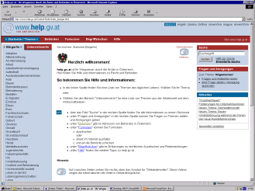
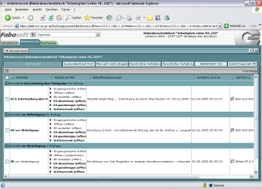
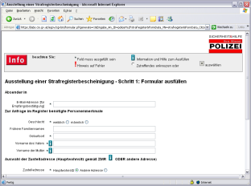
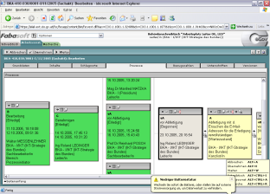
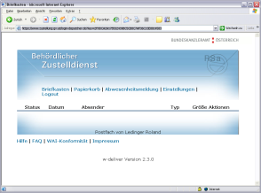
Goal: constant procedures
HELP.gv.at
USP.gv.at
Electronic File System (ELAK),
Central Register
www.zustellung.gv.at
(eDelivery)
portal
eDelivery
service
backoffice

Slide 15
Registers a base element in the back office
three main core data (sets):
  Citizens
  Business
  Objects (buildings, addresses, …)
central core data are necessary to
  optimize official procedures
  minimize data clearing between organizations
  have a valid base for taxes, statistics, eID, ….

Slide 16
Registers interconnection of base data
Citizens
core data
e.g. substitute for
a company
e.g. live at address
Business
core data
objects
core data
e.g. established
at address

Slide 17
Interoperability
‘Interoperability, within the context of European public service delivery, is the ability of disparate and diverse organisations to interact towards mutually beneficial and agreed common goals, involving the sharing of information and knowledge between the organisations, through the business processes they support, by means of the exchange of data between their respective ICT systems.’ [EIF]

Slide 18
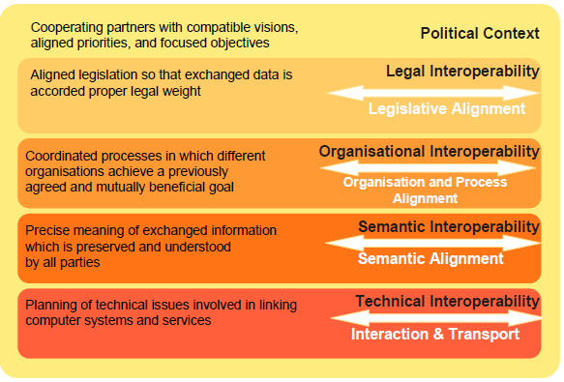
European Interoperability Framework 2.0

Slide 19
the basic elements
Inter-
operability
eID
eDOC

Slide 20






Member States cooperate in key policy areas
eID interoperability
eHealth
eJustice
Service Directive
eProcurement
www.eid-stork.eu
www.epsos.eu
www.e-codex.eu
www.eu-spocs.eu
www.peppol.eu

Slide 21

General feeling: missing confidence?

Slide 22

Lessons learned …
holistic approach,
comprehensive framework
include horizontal key enablers
in the big picture
reduce complexity
don‘t think in SILOS …
reInventing the Wheel ‚syndrom‘
ISA strategy <-> national/local strategy
share Sevices (eForms, eID, …)
local services IMPORTANT
Initiatives: Digital Austria, Digital Cities, … Help.Partner
…
Notes:
22

Slide 23

‚Next Generation‘?
workplace of the future (2020)
big data
synergies in/with e-sectors
eID / federation of portals
portals – mashups, SSO, …
register queries / ‚BOGD‘
granularity of services -> aggregated services (responsive)
Open Government Data (OGD) / FIA / PSI
feedback of citizens is necessary <-> citizen centric
capacity building / skills
Government

Slide 24
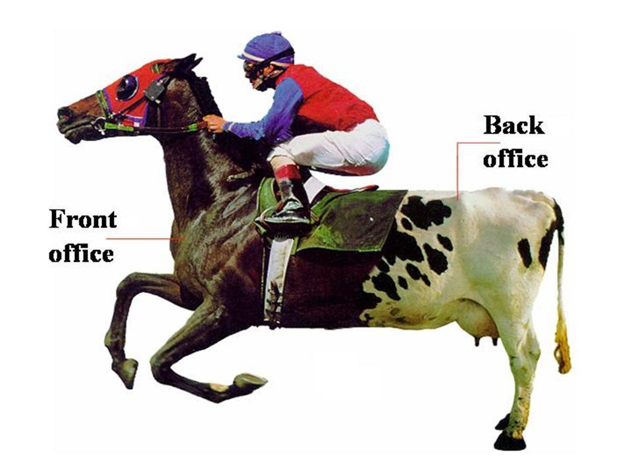
Where is the ‘e-/m-/-……..’?

Slide 25
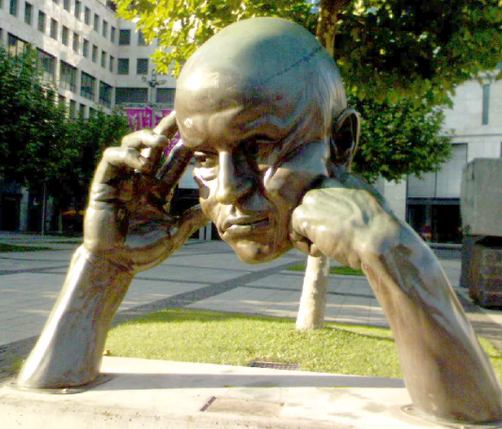


Thank you!
Questions?
peter.reichstaedter@parlament.gv.at
http://at.linkedin.com/in/reichstaedter
Austrian Parliament / Parliamentary Administration - IT
http://www.parlament.gv.at/
http://www.digital.austria.gv.at/
http://reference.e-government.gv.at/
Results and specifications available online (unfortunately mostly only in German ☺, but we’re doing our best … )
http://www.help.gv.at/

Slide 26

European Cloud Partnership (ECP) /
Cloud4Europe
Notes:
ec.europa.eu/digital-agenda/en/european-cloud-partnership
www.cloudforeurope.eu

Slide 27

Peter Reichstädter
Peter Reichstädter is CIO of the Austrian Parliament; before he was working for the Federal Chancellery of the Austrian Republic in the Division for the Austrian ICT-Strategy / Department of ‘law, organisational and international issues’, which is responsible for the elaboration and coordination of the Austrian E-Government strategy within the initiatives of i2020 (ISA & ISA² program - there he was leading the focus working group on Austrias Interoperability Framework) and Digital Agenda. He was there responsible for coordinating and establishing E-Government architecture and basic E-Government services (Model of electronic delivery, Interoperability Frameworks, …). Peter is also strategic technical advisor at the e- Europe-Award 2003 honored project of www.help.gv.at. In this function he is coordinating the needs and necessary project steps towards establishing help.gv as the main Austrian transactional E-Government portal.
Furthermore Peter is board member of the Austrian Computer Society and head of the working group on E-Government / Interoperability aspects, …); author of many specific publications, organizer of computer science and law tracks in conferences, lecturer at the E-Government and E-Commerce courses of studies at the Danube-University Krems, Applied Sciences university FH Joanneum, FH Wr. Neustadt, FH Eisenstadt, research partner at Viennas technical University and member of different EU-relating working groups (“Portal of the EU Administration" - Your Europe, European Interoperability Framework, Interoperability Architecture, …) elaborating the main points of the trust and security as well as adding contributions to OECD E-Government peer review initiatives & other OECD working groups.
CIO // Senior E-Government Architect & Strategy Evangelist
peter.reichstaedter@parlament.gv.at
Austrian Parliament

