Slide 1


Решения EMC для Больших Данных
Управляйте на основе Данных
Саяпин Виталий, Директор по исследованиям и разработкам EMC в Казахстане.
Notes:
The goal of this presentation is to help organizations maximize the opportunities of Big Data by transforming into a data driven organization, whereby every user in the organization places heavy value on data and analytics for decision making
This transformation requires a new, agile approach to 3 things - technology, people, and processes- that all lead to the same goal: Build a Data Lake, derive insight, and integrate insight into software applications for data-driven decision making

Slide 2































Что такое большие данные?
Интернет
Предприятие
Структурированные Данные
Неструктурированные Данные
Данные о местоположении
Публичные записи
Социальные сети, ПОЛЬЗОВАТЕЛЬСКИЙ КОНТЕНТ
Темные Данные
Интернет Вещей
Notes:
Big Data can mean different things to different organizations, so let’s first define what big data is. Most traditional data was structured, or neatly organized in databases found within the Enterprise. Then the world went digital and the Internet came along and there was a proliferation of unstructured data generated by all our digital interactions, from email to online shopping, text messages to tweets, Facebook updates to YouTube videos.
The industry definition of big data continues to evolve, but we commonly hear it described by Gartner as the ability to store and analyze new sources of data characterized by “volume, velocity, and variety” which was previously too difficult, expensive, or time consuming to exploit.
And these new data sources can be found inside the enterprise and outside on the Internet – they are growing in high volumes, generated at high velocities, and include both structured and unstructured data varieties.
Let’s take a look at some examples Inside the enterprise – all of which a large percentage has been untapped for analysis due to data warehouse constraints and technology limitations
You have structured data managed in systems such as relational database systems.
Unstructured data such as user generated files – documents, videos, images, etc.
Dark data- or detailed data such as transactions and log data: Web site traffic logs, Email logs, Employee attendance logs, Sales call center logs, Customer support logs, System events on servers and networks, Instrumentation logs
Examples outside the organizations on the Internet:
Open Data or public records — budgetary and socio-economic (cities, states/ provinces, countries), environmental data (land, oceans, weather, astronomy), law enforcement, sports data.
Location data – GPS enabled phones generates location data
Internet of Things (IoE) — the gadgets recording and transmitting data, from smartphones to wearables, to intelligent fridges, smart TVs, thermostats, cars, environmental sensors, and other devices
Social networks — which includes both public and private data.
Personal data — which includes private and anonymized public healthcare info, personal lifelogs and to-do lists in the cloud, etc.
Other user-generated content (UGC), such as video uploads
Commerce transactions — both online and in-person private and anonymized public data.

Slide 3








Каков объем данных?
Объем Данных Удваивается Каждые Два Года
2013: 4.4 Зеттабайт
2020: 44 Зеттабайт
1 ZB = 1B TBs
44 Зеттабайт примерно в 50 раз превысит число всех песчинок на всех пляжах планеты
К 2020 году
к Интернету будут подключены:
7.6B
людей
200B
вещей
Notes:
To give you perspective on how much data we are talking about, in 2013, the US Chamber of commerce reported that about 90% of all the data in the world today has been created in the past 2 years.
According to IDC’s recent Digital Universe report, data is doubling every 2 years and by 2020 there will be 44 zettabytes or 44 billion terabytes of data.
The study identifies machine-generated data as the fastest-growing source of information from the Internet of Things as there will by 7.6 B people connected to 200B things by 2020.
You might be wondering where is this Big Data stored and why is it important?

Slide 4








Почему Большие Данные Важны?
Понимать
Поведение Заказчиков
Оптимизировать
Операции
ВОЗМОЖНОСТИ
Управлять
Рисками
ОБЛАЧНЫЕ
СЕРВИСЫ
Внедрять
инновации
Notes:
It is important because we now have new technologies such as Hadoop and cloud services to be able to efficiently store and analyze this data for new business opportunities.
Forward thinking Internet companies such as Google, Amazon, and LinkedIn were able to leverage Big Data to shift the focus of analytics from not just measuring the past but to anticipating the future. And this is an extension of traditional data mining where you build predictive models, but the difference is now is through technologies such as Hadoop, there is more agility and the ability to analyze larger data sets to quickly create more accurate predictive models that deliver unprecedented results.
For example, Amazon’s ‘People who viewed this item also bought’ is based on predictive models to ensure a likely outcome. Today, over 1/3 of sales at Amazon are based it’s predictive recommendation and personalization systems. These forward thinking companies not only collect and analyze repositories of information about transactions, products, customers, and suppliers, but also the wealth of information that exists on the Internet; public records, market intelligence, mobile data from public wifi, Twitter feeds, and general online chatter to Better Understand Customer Behavior in order to build more accurate predictive models.
You can categorize these business opportunities in 4 areas:
Better Understand Customer Behavior – leveraging Big Data to gain deeper customer insights for optimized targeting: 1) Acquire new customers through optimized ad targeting and campaign execution 2) Mature existing customers through improved customer loyalty programs and up sell/cross sell opportunities 3) Retain customers by proactively identifying at risk customers and offering more competitive pricing
We talked about Amazon leveraging Big Data to better understand customer behavior.
Optimize Operations- leveraging Big Data to decrease operational costs through predictive/forecasting based applications: 1) demand forecasting, 2) network operations 3) supply chain operations 3) business processes 4) predictive maintenance 5)product quality 6)pricing optimization
To protect its lucrative business servicing machines, GE turned to the Industrial Internet. They knew they had to use analytics or predictive maintenance to better service machines or other software companies would soon take this servicing business away. GE manufactures jet engines, turbines and medical scanners. It is using operational data from sensors on its machinery and engines for analysis to provide services designed to minimize downtime caused by parts failures. Real-time analytics also enables machines to adapt continually and improve efficiency.
Better Manage Risk - Enabling organizations to gain more accurate insight in detecting fraud and assessing risk
The Climate corporation provides insurance to farmers leveraging Big Data to better assess agricultural risk through the prediction/forecasting of weather and other essential elements. They were recently bought by Monsanto to optimize farming globally.
Enable Innovation - Introduce new products and services, monetize data, change industry dynamics, or make a positive societal impact
Uber has transformed the taxi industry through a business model that heavily relies on Big Data- passenger locations, payments, driver attributes, market data, and more to predict pricing, safety, and quality of service.

Slide 5
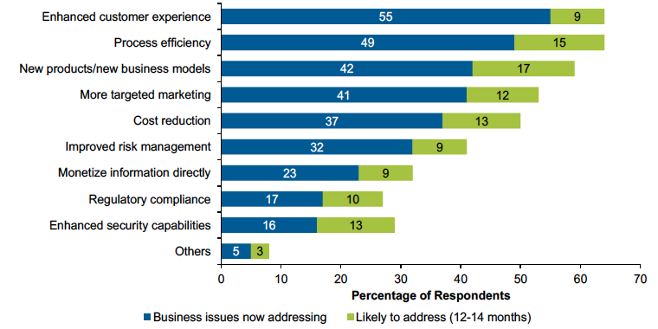
Где фокусироваться?
Понимать Поведение Заказчиков
Оптимизировать Операции
Управлять Рисками
Понимать Поведение Заказчиков
Оптимизировать Операции
Управлять Рисками
Внедрять инновации
Управлять Рисками
Управлять Рисками
Gartner 9/13: Анализ опроса по внедрению больших данных в 2013 показывает суть
Notes:
Given all the opportunities made available through Big Data, where can you as an organization start or focus? These opportunities can be broken down into use cases. This 2013 Gartner survey provides examples of how over 465 organizations worldwide are using Big Data:
Understanding Customer Behavior is the top opportunity as 55% of respondents are using Big Data to enhance customer experience.
Optimizing Operations is the second most important opportunity as 49% are using Big Data for Process Efficiency.
Do any of these use cases resonate with you?
Please note: We have use cases broken down by industry.

Slide 6
Возможности Больших Данных по индустрии
Правительство
70%
Эффективность процессов
59%
Сокращение затрат
56%
Улучшенное управление рисками
48%
Новые продукты/модели
48%
  Качество обслуживания заказчиков
44%
Монетизация информации непосредственно
37%
Соответствие требованиям регуляторов
33%
  Более таргетированный маркетинг
33%
Возможности повышения безопасности
Gartner 9/13: Анализ опроса по внедрению больших данных в 2013 показывает суть

Slide 7


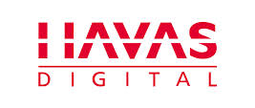
Примеры Заказчиков EMC
Использование больших данных для ‘Понимания Поведения Заказчиков’
Easynet позволяет ритейлеру повысить доходы на одного клиента на 5% за счет улучшения программы лояльности клиентов
Knotice позволяет продавцам увеличить коэффициент конверсии на 700% в Черную пятницу путем улучшения таргетированной рекламы для клиентов
Havas Digital позволил Туристической компании увеличить объем продаж на 27% и рентабельность до 300% посредством лучшей оптимизации кампании
Notes:
Since Understanding Customer Behavior is the top opportunity, here are some examples of EMC customers that are using Big Data to gain real value:
Easynet is an EMC DCA customer enhancing customer experience
Knotice is an EMC DCA customer improving targeting marketing use case
Havas is a Pivotal customer improving targeting marketing

Slide 8



Почему необходимо действовать сейчас?
“ В 2015, организации интегрирующие высоко ценные, разнообразные, новые типы информации и источники в единую инфраструктуру управления информацией будут опережать своих индустриальных коллег финансово более чем на 20%. "
“ Мы создали то, что выглядит как софтверная компания, и мы движемся от разрозненных систем к единой платформе.”
«Этот переход требует полного пересмотра банками технологии ... это вопрос выживания ... теперь у нас есть современные платформы."
Notes:
Why Act Now?
If you don’t leverage Big data you will be outperformed by your peers
But it’s not enough just to analyze data, the insight gained needs to be easily consumable through software or application delivery
And it is not just digital born companies that rely on software to run their company and have transformed industries such as Uber, but also brick and mortar companies such as financial institutions or banks must leverage Big Data or will become extinct such as Blockbuster after Netflix transformed the movie rental business.
Source 1: Gartner, Information Management in the 21st Century, September 2, 2011
Source 2: Platform: The Cloud Foundry Conference - Jonathan Murray
http://www.youtube.com/watch?v=LIg7TO0CaKA
Source 3: Financial Times – Banks need to take on Amazon and Google or die – Francisco Gonzalez, Chief Executive BBA –
BBVA is the second largest bank in Spain, after Santander. Since 2006 the bank has focused on overseas expansion, and now operates in 40 countries. €22 billion revenue in 2012.
Some bankers and analysts think that Google, Facebook, Amazon or the like will not fully enter a highly regulated, low-margin business such as banking. I disagree. What is more, I think banks that are not prepared for such new competitors face certain death.
Technology has already transformed many industries. Next in line is banking. In two or three years, only 5 per cent of consumer interaction will be through branches. The rules have changed and a new league of competitors is emerging.

Slide 9
Ключи к Успеху: Максимизируйте Возможности
Текущая Ситуация
Предприятие Управляемое Данными
Неясные бизнес-кейсы
Дефицит навыков
Недостаток опыта
Жесткие процедуры разработки приложений
Сложное развертывание приложений
Изолированные
хранилища данных
Рост затрат на
управление данными
Оптимальные бизнес сценарии
Тренированный и опытный персонал
Agile методология разработки
Платформа как сервис (PaaS)
Озеро Данных (Data Lake)
Упрощенное управление данными
Люди
Процессы
Технология
Notes:
So how can you gain the opportunities of Big Data and maximize them in order to transform into a data driven enterprise? Sure you can start a few Big Data projects and gain incremental value, but the keys to success are to maximize opportunities through the transformation of people, processes, and technology from your current situation to a Data driven enterprise.
So let’s take a look at the characteristics of an organization’s current situation and what’s needed to become data driven:
An unclear business case may be a characteristic of your current situation. The path to become data driven starts with a business case, or business driven process to use Big Data as a means to meet clear, tangible goals. Executives paint a vision that aligns with the organization’s business initiatives, and the line of business managers define metrics or tangible goals. For example, if the vision is to leverage Big Data to boost sales in the Southwest, the specific metric or goal can be “increasing product sales by 10% in Arizona in the winter.
The challenge here people or lack of skills and and experience in order paint this vision and identify a use case that delivers value, as well as skills in the area of Hadoop and Data Science to execute on a Big Data project based on an identified and optimal use case.
So the first step to becoming data driven is a well trained and experienced staff that can collaborate with the business and IT to uncover an optimal use case for business value.
The more agile you are in capturing Big Data, deriving insight from it, and creating or updating applications to reflect newer insights, the more data-driven you will become. This is how you grow your business through rapid iteration or the ability to quickly add new features or application logic based on analytics. The challenge here are the traditional application dev and deployment processes that are rigid and cannot quickly iterate. This requires new, agile processes and technologies such as PaaS to quickly operationalize insights.
Because Big Data projects are business driven, it is very common for individual business departments to bypass IT and use Big Data cloud services or dept-managed Hadoop environments - introducing data silos and escalating data management costs due to these silos and the sheer fact data is doubling every 2 years. According to EMA: Operationalizing the Buzz, November 2013, an organization on average has 2.5 Big Data projects. To support these Big Data projects in a more efficient, cost-effective way, organizations can take control and move from siloed data architectures to an IT managed Data Lake architecture, where all enterprise data is managed in Hadoop and accessed and used equally by all business applications. To simplify management, all new applications will be built on the data lake, all applications will share data there, and data governance and security processes will be applied there; only a few legacy or specialized applications will stand alone.

Slide 10
Ключи к Успеху: Люди
Текущая Ситуация
Решения EMC
Дефицит навыков
Недостаток опыта
Недостаток соответствующих экспертных знаний
Учебная программа EMC
по Большим Данным
Pivotal Data Labs
Люди
Процессы
Технология
Notes:
So lets first look at how EMC can help with the ‘People’ transformation. EMC offers 2 services to overcome lack of skills and experience so that you have a well trained staff to successfully identify opportunities and execute on Big Data projects

Slide 11
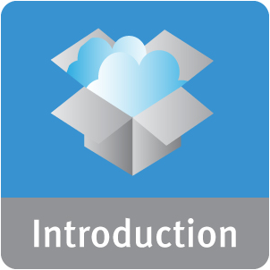


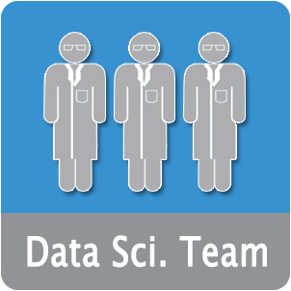

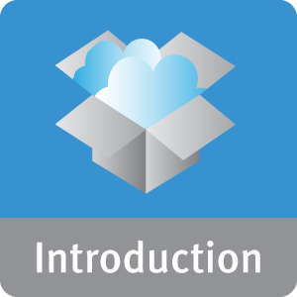

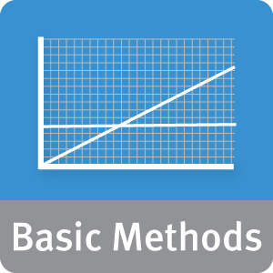

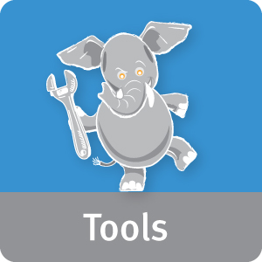
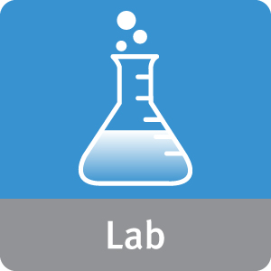
Учебная программа EMC Big Data
Получите навыки для немедленного и эффективного участия в проектах по Большим Данным
Руководители
90 мин.
Представляем науку о данных и аналитику больших данных для трансформации бизнеса
Бизнес Лидеры
1 день
Наука о данных и аналитика больших данных для трансформации бизнеса
Специалисты по анализу данных
5 дней
Наука о данных и аналитика больших данных
Notes:
So we talked about Big Data opportunities as being a business driven process starting from the top down, with executives painting a Big Data vision and business leaders building agile teams that include Data Scientists to identify opportunities and execute on this vision?
EMC has designed a comprehensive training program for Executives, Business Leaders, as well as Data Science with the goal to gain the skills necessary to immediately and effectively participate in Big Data projects.
90 min course for Executives:
The goal of this course is to transform executives into data-savvy business leaders who can identify opportunities to solve business problems using advanced analytics. This course provides a baseline understanding of Data Science and Big Data and industry specific examples of deriving business value from Big Data and key elements for driving a cultural change so that everyone in the company shifts towards a data-driven mindset.
1 day course for Business leaders and Managers:
The goal of this course is to train business leaders on what is required to effectively run Big Data projects which includes how to apply advanced analytics to Big Data and how to build lead analytical teams.
5 day Data Science course
For data scientists the goal of this course is to gain the skills needed to execute on Big Data projects. It includes an introduction to big data and the Data Analytics Lifecycle to address business challenges that leverage big data. The course provides grounding in basic and advanced analytic methods and an introduction to big data analytics technology and tools, including MapReduce and Hadoop. Labs offer opportunities for students to understand how these methods and tools may be applied to real world business challenges by a practicing data scientist.
Sidebar: A data scientist in not your traditional data analyst as these professionals go beyond basic reporting and trending to predictive analytics. Data Scientists have a diverse skill set that combines technical and quantitative skills with creativity and communications skills. They have strong background or foundation in Mathematics, Statistics, Programming, and Databases. But beyond that you need to be able to work in a team environment and have communication skills to collaborate with the IT, Lines of Business, Executives, and explain results back to them. They care about what the problem is and how to solve it. The other important traits are that you need to be curious, like to solve problems, and always be skeptical about your results.

Slide 12



Pivotal Data Labs
Получите опыт через Проекты в области Больших Данных под руководством Экспертов в Науке о Данных
Ознакомление
Новые идеи
Результаты
Обязательства: Pivotal ведет Бизнес и Техническое Согласование с Заказчиком
Исследование данных, оценка готовности и подготовка
Сочетание области знаний и науки о данных для прогнозного моделирования
Документация кода
и обмен знаниями
Продолжительность взаимодействия 1-12 недель
Notes:
In addition learning skills, your staff can gain real experience with Big Data projects when engaging with a Pivotal Data Labs service.
This service brings a team of experienced, industry specific Pivotal data scientists to your site to work with your team to shorten the timeline to reach actionable analytical results. Pivotal Data Scientist work on a daily basis with your analysts, data platform administrators, and business leadership to discover new opportunities if they have not been identified, gain insight, and provide actionable results all on an accelerated schedule.
Sidebar: A data scientist in not your traditional data analyst as these professionals go beyond basic reporting and trending to predictive analytics. Data Scientists have a diverse skill set that combines technical and quantitative skills with creativity and communications skills. They have strong background or foundation in Mathematics, Statistics, Programming, and Databases. But beyond that you need to be able to work in a team environment and have communication skills to collaborate with the IT, Lines of Business, Executives, and explain results back to them. They care about what the problem is and how to solve it. The other important traits are that you need to be curious, like to solve problems, and always be skeptical about your results.

Slide 13

Пример заказчика: Обучение персонала
Цели
  Лучше понимать и обслуживать заказчиков, используя новые наборы данных большого объема
  Экономичные средства для роста базы данных и сложного анализа данных
Решения
  EMC Data Computing Appliance (DCA)
  Сервисы Pivotal Data Labs
Результаты
  Улучшение удержания клиентов благодаря более быстрому выявлению подверженных риску клиентов
  Легко масштабируется - от 6 до 11 ТБ данных
Notes:
Zions Bancorporation is one of the nation’s premier financial services companies, consisting of 17 banks and companies. With headquarters in Salt Lake City, Utah, Zions operates over 500 banking offices in 10 states across Western and Southwestern US. Zions is included in the S&P 500 and NASDAQ Financial 100 indices.
They had a business case, but lacked the experience execute on a Big Data project to improve predictive models to identify at-risk customers by using more data sources and newer techniques.
Zions Bancorporation’s growth strategy focuses on utilizing Big Data – high-volume, varied data assets – to engage customers in new ways, generate business demand and increase revenue streams. The company must also satisfy an array of data intensive privacy and regulatory requirements.
The increasing volume, variety and velocity of data at Zions Bancorporation put analytic demands on its existing Oracle data warehouse that it simply could not handle.
Reduce customer attrition – Developed model that scores a customer’s likelihood of leaving the bank based on behavioral trend, enabling Zions Bank to faster identify at risk customers attrition by analyze more detailed behavioral data - direct deposit, bill pay, etc
Case study:
http://www.gopivotal.com/sites/default/files/Zions_Bancorp_CS_GPDB_PS_2014.pdf

Slide 14
Ключи к успеху: процессы
Текущая ситуация
Решения EMC
Неясные бизнес-кейсы
Жесткие процедуры разработки приложений
Семинар EMC Big Data Vision
Pivotal Labs
Люди
Процессы
Технология
Notes:
Organizations must not only implement training programs to develop people, but also implement new, agile processes to react to the market quickly. With EMC Federation offers services to put new methodologies in place so teams of people work together collaboratively to continuously identify Big Data opportunities and deliver to the market quickly.

Slide 15
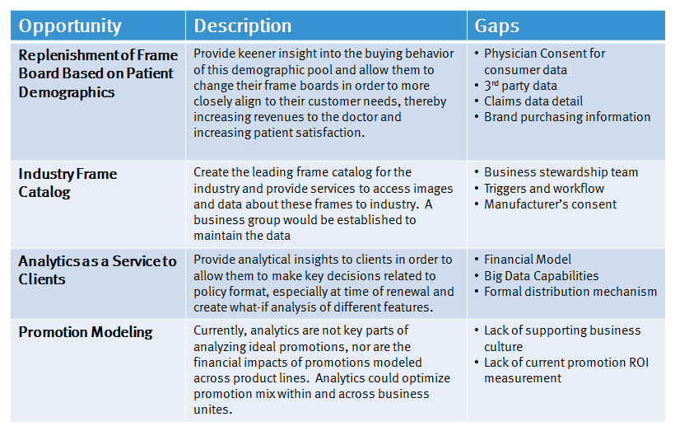
Семинар EMC Big Data Vision
Процесс совместной работы для выявления оптимальных сценариев использования больших данных
Изучение
Анализ
Идеи
Приоритет
Документ
Определение ключевых бизнес-инициатив, целей и временного периода
Подготовка примеров клиентских данных
Выбор новых спецефических идей для клиента
Представление потенциала
больших данных для бизнес инициатив
Приоритезация возможностей
Определение препятствий
Отражение возможностей аналитики
Рекомендация следующих шагов
1 день семинар (2 недели взаимодействия)
Notes:
Organizations recognize that its not enough to just collect Big Data in Hadoop, but to continuously ask the right questions to solve business problems. That’s the real value. The Big Data Vision Workshop provides a methodology where the business and IT work together to ask the right questions to uncover Big Data use cases. For example, the workshop examines how you can get a Big Data project started by focusing on a key business process that is already supported by your existing business intelligence and data warehouse environment. Leverage Big Data to take that business process to the next level.
For example, this methodology provides a foundation for your organization to continuously dig deep into Big Data to see how the organization can re-wire their interactions with customers to build a more engaging, more sticky, more profitable relationship.
1 day workshop process and deliverables:
Research and interviews to understand targeted business area
Data preparation and client-specific analytics development
Envisioning exercises to convey the “realm of the possible”
Identify, brainstorm and prioritize big data use cases
Define a Proof of Value (POV) project with clearly defined goals, tasks and requirements

Slide 16
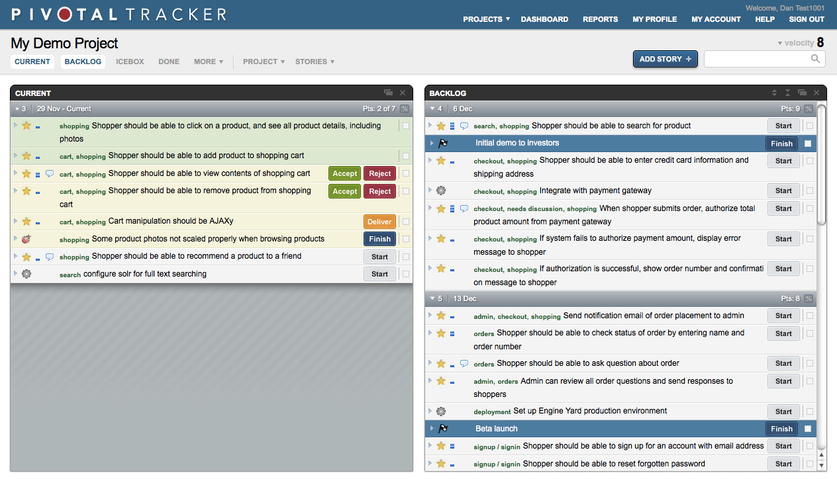





Pivotal Labs
Agile Методология Укорачивает Цикл Разработки
QA
Выпуск
Отклик
Определение/Приоритеты
Кодирование
Построение
Гибкие практики разработки обеспечивают быстрый отклик на рыночные изменения
Pivotal Tracker обеспечивает полный контроль над проектами
Подход совместного парного программирования обеспечивает лучшие продукты за меньшее время
Notes:
Organizations recognize that in order to become data driven, insights from Big Data need to be easily accessible or consumable through software. And this software generates more data, creating newer insight. And this new insight must then be integrated into the application again. The speed at which you can cycle through capturing data, analyzing it, and upgrading the application, the more your business will grow.
To accelerate the application development component of this cycle, Pivotal Labs provides an agile methodology with a project management tool called Pivotal Tracker to develop faster and deliver higher quality of code. Pivotal Labs partners with a client’s technical team with the goal to bring agile practices home with them and strengthen their in-house development. Twitter, eBay, and Salesforce are examples successful companies using Pivotal best practices and tools to deliver software.
Agile development practices – Pivotal’s approach includes inception, iteration planning, daily standup meetings, test driven development, pair programming, iterative development, and project management.
Proprietary project management tool – Pivotal Tracker is an agile project management tool that enables real-time collaboration around a shared, prioritized backlog. Originally an internal tool, it has become the tool of choice for more than 100,000 developers worldwide.
• Collaborative approach - We provide expertise in three competencies equally crucial to delivering the best product: design, development and product management. Integrating these roles is a key part of our agile process. This cross-functional collaboration between designers, developers and product managers brings out the best features, design and product.
• Pair programming – Pivotal Labs’ developers work in pairs so that they can easily refine ideas, weed out bad ideas early, and make progress consistently and rapidly.
• Specialties – Pivotal Labs’ specializes in projects that involve Ruby and Ruby on Rails, JavaScript, iOS and Android, NoSQL, and Python technologies.
• Broad range of services – Clients count on Pivotal Labs to deliver web and mobile development; visual, interaction, and user experience design; product management; and training and coaching services.
• Cross-industry experience – Pivotal Labs has helped clients in the mobile games, financial services, healthcare, government, and consumer products industries.

Slide 17

Пример заказчика: Agile Разработка Приложений
Цели
  Создать решение SaaS с широкими возможностями для постоянно расширяющейся вселенной данных социальных сетей
  Обеспечить согласованную и надежную архитектуру для получения аналитической информации в режиме реального времени от данных из Twitter, Facebook, Tumblr, WordPress, Instagram и многих других источников
Решения
  Pivotal Labs (Практики Agile разработки)
  Pivotal Tracker (Управление проектами и сотрудничество)
Результаты
  Помогли запустить сервис и дали рекомендации по разработке
  GNIP способен управлять экосистемой публичных социальных данных по всему миру
  Охватили 90% бизнеса из Fortune 500
Notes:
GNIP, recently acquired by Twitter, is an example of a digital born company that knew it could not rely on a traditional and sequential software development process to grow its business and compete with other social media service providers. Rapid application iteration was key to quickly deliver high quality features and services to its customers.
Through Pivotal’s agile development practices enabled through Pivotal Tracker, GNIP was able to successfully launch the first Twitter data collector and then subsequently first to market a filter for the Twitter firehouse. With continuous delivery of new services, they dominated the social media service provider market capturing the business of 90% of the Fortune 500 and eight of the nine largest social media monitoring firms.
GNIP is the world’s largest provider of social media data, serving customers in a range of industries from social media monitoring and business intelligence to finance and government and was recently acquired by Twitter.

Slide 18
Ключи к успеху: Технология
Текущая ситуация
Решения EMC
Изолированные
хранилища данных
Рост затрат на
управление данными
Сложное развертывание приложений
EVP Data Lake
Pivotal CF
Люди
Процесс
Технология
Notes:
As discussed earlier, in addition to people and process, technology needs to provide the agility in order to become data driven. This requires the transformation of a data and application environment that is siloed, costly, and complex to one that is central, cost-effective and flexible such as a Data Lake with Platform-as-a-Service.
Through the EMC Federation (best-of-breed, integrated solutions from EMC Information Infrastructure, VMware, and Pivotal), EMC offers an EVP Data Lake solution as well as PaaS through industry leading Pivotal CF. EMC allows offers a modular approach to a Data Lake with choice of storage, computing, and appliance to optimize your data and application environment as you to move towards a Data Lake.

Slide 19

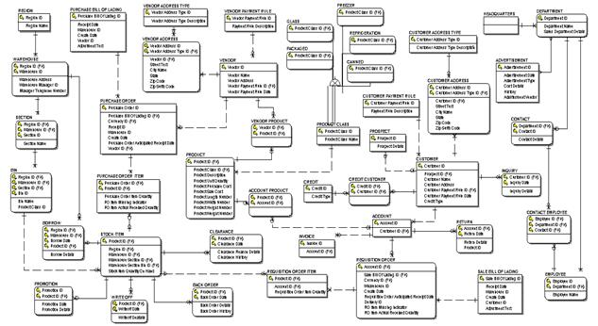










Аналитическая среда сегодня
Разрозненная и дорогостоящая
Источники Данных
Хранилище
данных
Корпоративные приложения
Приоритезированные
Операционные процессы
Создание отчетов
Витрины данных
Облачные
сервисы
Не приоритезированное
Предоставление данных
Notes:
Todays’ analytic environment is complex with multiple copies of data occurring. New techniques for data analysis are also being adopted – requiring yet more data copies, and newer higher volumes of data are being generated and analyzed. These new analysis platforms are being provided outside of the typical IT infrastructure and leads to greater management and security problems for organizations. Data sets not being properly secured and controlled, greater management complexities for the difference processing environments are only some of the challenges for IT.

Slide 20





Архитектура для «Озера данных»
Централизация системы хранения данных, обработки и служб приложений
Загрузка
Хранение
Анализ
Раскрытие
Действие
Извлечение данных из различных источников, традиционных и новых.
Хранение всего в одной среде для перекрестного анализа наборов данных.
Применение современных алгоритмов для обнаружения новых схем прогнозной аналитики.
Совместное использование информации с экспертами из бизнес области.
Создание приложений соответствующих потребностям бизнеса на основе данных
CLOUD
SEVICES
Notes:
One way to deal with this data and processing sprawl is to create a “Data Lake” – a storage repository that can accommodate all data types and ingest mechanisms which provides a standard analytic platform for today’s new business requirements.

Slide 21
EVP Data Lake
Минимизация разрозненных хранилищ через поддержку требований различных приложений
ДАННЫЕ
АНАЛИТИКА
ПРИЛОЖЕНИЯ
Поддержка нескольких протоколов позволяет использовать устаревшие приложения
СКОРОСТЬ
DSSD
CLOUDFOUNDRY
HDFS
GEMFIRE XD
NoSQL
REALTIME
NoSQL
РАЗНООБРАЗИЕ
VNX
ViPR
IN-MEMORY
SQL
Существующие данные, доступны для аналитики, используя HDFS
HDFS
HAWQ
INTERACTIVE
OTHER
NFS
SQL
SMB
ISILON
PIVOTAL HD
BATCH
HDFS
Позволяет удовлетворить потребности в обработке различных данных
ОБЪЕМ
MR
NFS
ViPR
ECS
APPLIANCE
S3
SWIFT
ATMOS
HDFS
HDFS
Модульная архитектура позволяет использовать некоторые или все компоненты
DCA
VMWARE
DATA LAKE
Notes:
The EVP Data Lake provides a central place for data storage, data processing and analytics, and application services to provide the agility needed to become data driven.
The EVP Data Lake is unique in that it can support diverse application requirements – 2nd platform legacy applications and 3rd platform modern applications through integrated products from across the Federation – EMC II, Vmware and Pivotal.
The EVP Data Lake is also modular in that you can use some or all of the components:
For data storage, you can use DAS, scale out NAS with EMC Isilon, or Software defined storage with EMC ViPR to meet any storage requirement. In fact, you can analytics enable data already living in storage arrays such as Isilon through its native HDFS protocol and ViPR Object and HDFS API access.
For data processing and analytics, Pivotal HD (Pivotal’s enterprise distribution of Hadoop) provides real time, interactive and batch processing services to meet all of your analytic requirements
Ultimately, the EVP Data Lake allows you to store everything, analyze anything, and build the right thing.
Again, EMC also offers a modular approach. So lets take a look at how you can use the individual components of the Data Lake to optimize your Hadoop deployment.

Slide 22



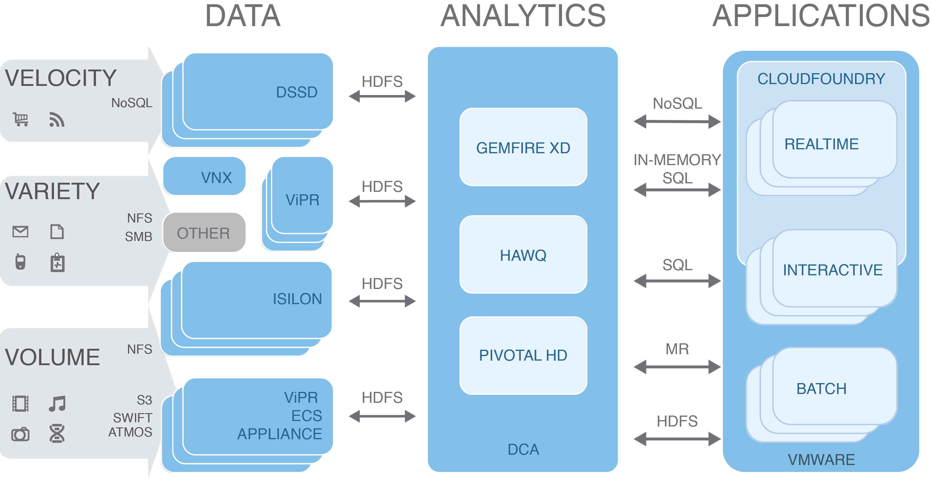
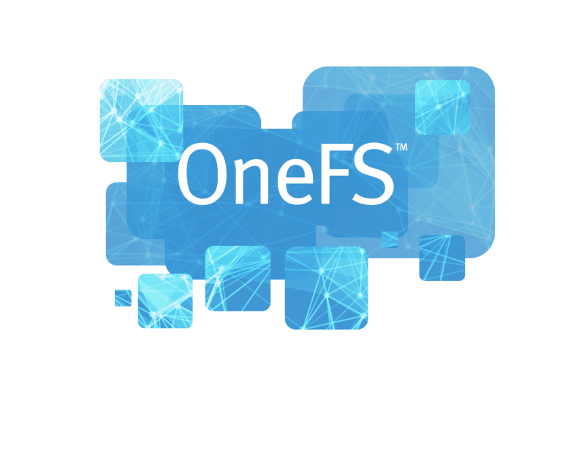

EMC Isilon HDFS-Enabled Storage
Консолидация системы хранения данных через многопротокольный доступ
Раздельное масштабирование вычислений и хранения данных
HDFS поддержка существующих данных:
обработка не нужна
Легкий импорт и экспорт через коммуникации следующего поколения: HDFS, NFS, SMB, HTTP, FTP
Полноценная защита данных от сбоев
Shares
Interactive
Real-time
Batch
Real time
Hadoop
HPC
Batch
SMB
HDFS
SMB
HDFS
FTP
REST
Analytics
FTP
REST
Mobile
SWIFT
NFS
SWIFT
NFS
HTTP
NDMP
HTTP
NDMP
Surface
Archive
Cloud
Act
Notes:
Leveraging HDFS enabled Isilon storage, you can easily consolidate Hadoop data into a single, scale out storage array. Not only do you eliminate multiple copies of data, but data is shared for better and faster insight. Leveraging Isilon you have the additional benefits: see above
Scale compute and data independently – over 80% storage capacity utilization - EMC Hadoop solutions can also scale easily and independently. This means if you need to add more storage capacity, you don’t need to add another server (and vice versa). With EMC Isilon, you also get the added benefit of linear increases in performance as the scale increases.
Automatically HDFS enable existing data – no ingest necessary
Ease of import and export, and support multiple applications via multi-protocol support – HDFS, NFS, CIFS, HTTP, FTP. This means that with EMC Isilon storage, you can readily use your Hadoop data with other enterprise applications and workloads while eliminating the need to manually move data around as you would with direct-attached storage.
Fault tolerant and end to end data protection - Isilon also eliminates the “single-point-of-failure” issue. We do this by enabling all nodes in an EMC Isilon storage cluster to become, in effect, name nodes. This greatly improves the resiliency of your Hadoop environment. The EMC solution for Hadoop also provides reliable, end-to-end data protection for Hadoop data including snapshotting for backup and recovery and data replication (with SyncIQ) for disaster recovery capabilities.
Rapid deployment with EMC Hadoop Starter Kit leveraging VMware vSphere - HSK enables IT to quickly and easily deploy a Hadoop cluster and provide Hadoop as a Service to the business in order to support Big Data projects. Through VMware vSphere, a virtual Hadoop cluster can be deployed using Isilon shared storage in just a few short hours with simple downloads of free software and documented configuration steps leveraging automation provided by VMware Big Data Extension

Slide 23
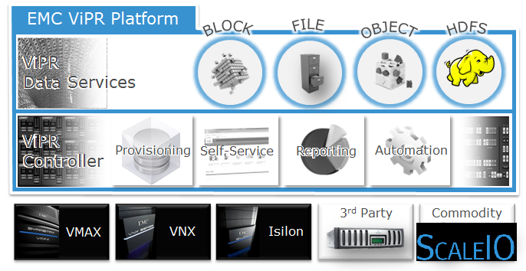
EMC ViPR Software Defined Storage
Сокращение разрозненных систем хранения данных через многопротокольный доступ
Поддержка анализа существующих массивов хранения
Поддержка HDFS, S3, Swift и Atmos API
Выбор оборудования для хранения данных: корпоративное, стандартное, устройства ECS
Notes:
Using EMC ViPR or software defined storage, you can consolidate data silos through virtualized arrays that support diverse big data applications through multi protocol support – object and HDFS.

Slide 24
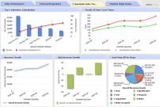

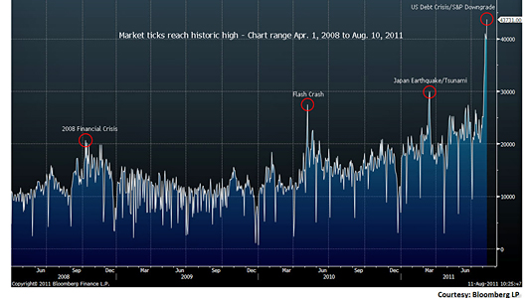







Аналитика: Pivotal HD
Консолидация разрозненной аналитики через различные службы обработки данных
Analytic Apps
Sensor Data / Feeds
Online Apps
Поддержка всех потребностей обработки данных.
  В реальном времени
  Диалоговая
  Пакетная
Поддержка многих типов интерфейса приложений:
  SQL
  MapReduce
  NoSQL
  In-Memory SQL
Pivotal HD
Enterprise
Map-Reduce
Model Refresh
GemFire XD
Model Refresh
HAWQ
Command Center
I/P & O/P
Formatter
PXF
Native Persistence
Re-evaluate Model
Re-evaluate Model
HDFS
Shared Data
Notes:
Pivotal HD is an industry leading Hadoop distribution providing real-time, interactive, and batch processing in a single Hadoop platform. Support for multiple interfaces enables users to leverage existing applications such as SQL for Hadoop processing.

Slide 25

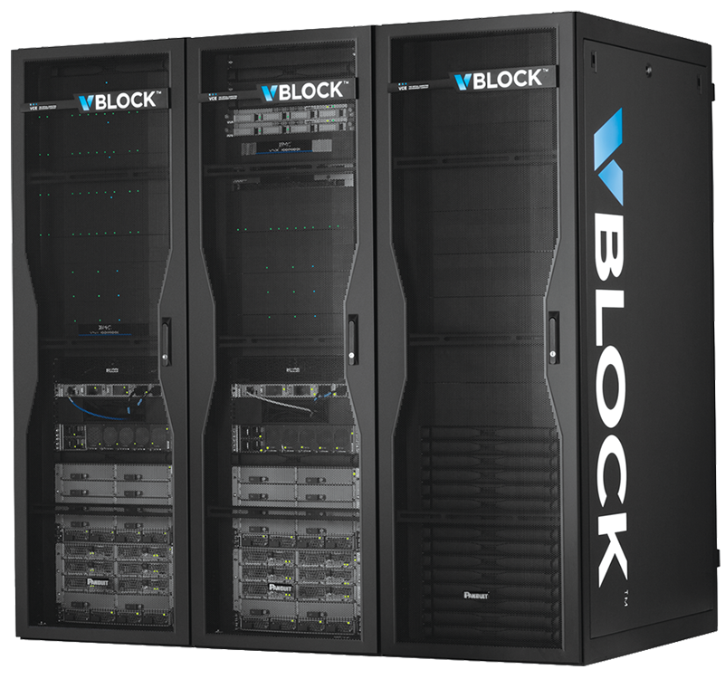
Связывание воедино: Устройства Hadoop
Легкое развертывание Hadoop с помощью предварительно интегрированных устройств
EMC DCA
Предварительная интеграция вычисления и хранения данных: Pivotal GPDB, Pivotal HD, EMC Isilon
VCE vBlock
  Предварительная интеграция сервера, хранения, сетей, виртуализации и управления.
  Поддерживает все основные дистрибутивы Hadoop
Notes:
Hadoop enabled appliances that optimize data processing and storage offer another option in consolidating data siloes but also simplified management to lower costs

Slide 26
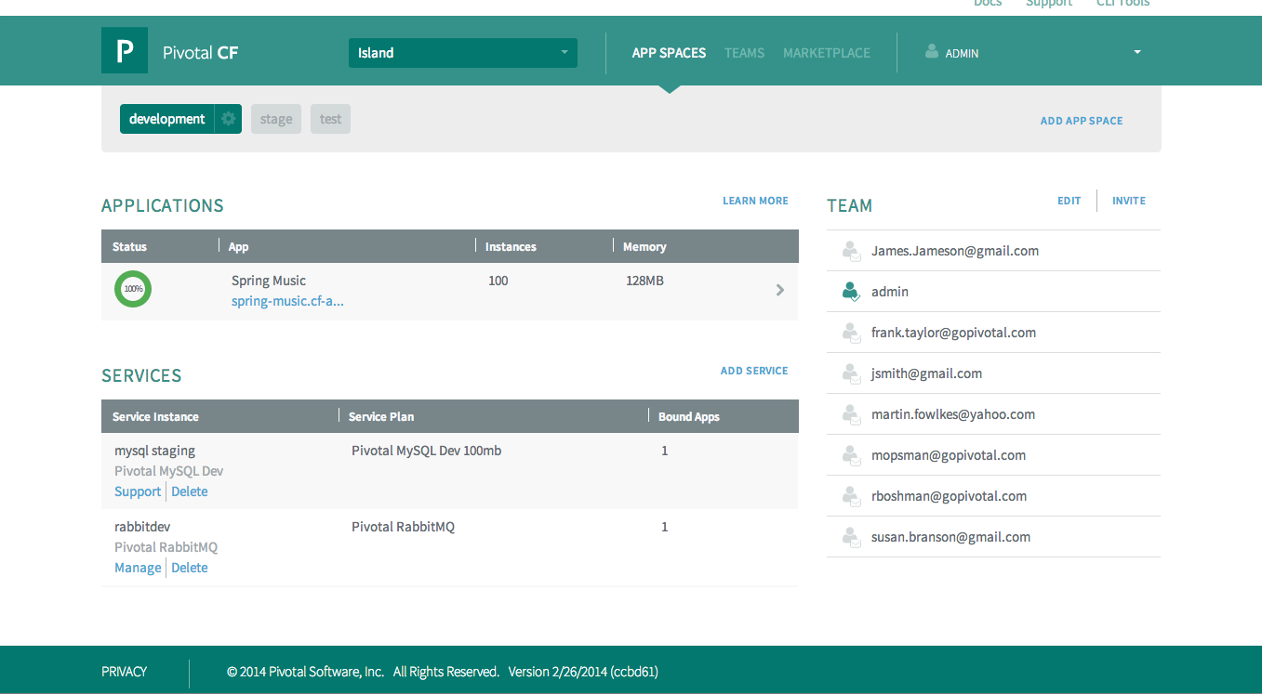




Непрерывная поставка приложений: Pivotal CF
Обеспечивает готовую к использованию PaaS с лучшими приложениями и сервисами управления данными
Разработчики могут сосредоточиться на разработке, а не на инфраструктуре
Отделение разработки приложений от операционной деятельности
Устранение узких мест выделения ресурсов и развертывания
Public
Private
Hybrid
Notes:
Pivotal CF is the leading PaaS (Platform-as-a-Service) – new application platform that abstracts infrastructure completely, and provides developers a set of standard application development frameworks, data services such as Hadoop, and templates for developing modern applications. Can run on Private, Public, or Hybrid Cloud models, empowering businesses to deliver applications and update them with new features at a velocity and scale previously only available to Internet giants, allowing enterprises to innovate with disruptive speed.
No need to configure VMs, databases, AppServers, Load-balancers…
Developers can focus on development and not infrastructure plumbing
Separate the concerns of AppDev and Operations
Eliminate the bottleneck of provisioning and deployment processes
Make full use of investments in the “Cloud”

Slide 27

Пример заказчика: Решение Data Lake
Цели
  Быстрый запуск нового сервиса аналитики рынка для розничной модной торговли
  Поддержка растущих объемов Больших Данных
Решения
  Pivotal Greenplum Database
  Pivotal HD
  EMC Isilon
  Pivotal Data Labs
Результаты
  Быстро запустили новый сервис
  Высокая производительность и масштабируемость с простым администрированием и управлением
Notes:
WGSN Group is a strategic intelligence, insight, and trends company. With offices throughout Europe, Asia, North and South America, and the Middle East, WGSN Group provides a combination of Big Data, deep intelligence, and sharp creative judgment to help its customers seize opportunities in accelerating markets. WGSN is a subsidiary of Top Right Group, an enabling company of media and information intelligence firms.
Challenge: New Service Requires Maximum Performance and Scalability
WGSN Group identified a promising opportunity to create a new market intelligence service that would help fashion retailers make crucial merchandising decisions.
The service would need to gather and process huge volumes of product, sales, and pricing data gathered from across the industry—and would grow exponentially as the user base expanded.
They knew this service required more storage than compute so required scaling compute and storage separately.
To successfully roll out the new service, named WGSN INstock, the company required an information infrastructure with the performance and scalability to handle both current and future Big Data requirements. After evaluating offerings from EMC®, NetApp, and IBM, WGSN chose EMC Isilon® scale-out storage along with Pivotal™ Greenplum® Database and Pivotal HD (Pivotal’s Hadoop distribution) to provide a comprehensive Big Data analytics solution.
Getting WGSN INstock to market quickly was a critical aspect of the company’s competitive strategy. After finalizing the analytics platform, the company deployed Isilon with Pivotal Greenplum Database and Pivotal HD in less than four weeks. “Because the two platforms are so tightly integrated, Isilon and Pivotal saved our development team considerable time on implementation,” Harley remarks. “The native integration with Hadoop also really streamlined the deployment process.” He adds, “Now that WGSN INstock is in production, we find it very easy to administer. We were even able to plug our monitoring solution into the system so we can proactively address any potential issues.”

Slide 28

Сотрудничайте с EMC
Люди: EMC предоставляет опытных специалистов анализа больших данных и науки о данных для обучения ваших сотрудников и для успешного исполнения
Процессы: EMC предлагает проверенные методики для реализации управляемых бизнес требованиями, гибких процессов обеспечивающих большую ценность
Технология: EMC предлагает последние, лучшие в своем классе инфраструктурные решения для упрощения архитектуры ваших данных и превращения их в «озеро данных»

Slide 30
Big Data Opportunities By Industry
Eleven Industries
Manu & N. Res.
Media/Comm
Services
Government
Education
Retail
Banking
Insurance
Health Care
Transportation
Utilities
Gartner 9/13: Survey Analysis: Big Data Adoption in 2013 Shows Substance Behind the Hype
Notes:
NOTE to PRESENTER: From the following slides, Select the industry slide that is closest to that of the customer. Copy the relevant slides as slide #6 in the deck.

Slide 31
Big Data Opportunities By Industry
Manufacturing And Natural Resources
69%
Customer experience
64%
Process efficiency
58%
New products/models
56%
Cost reduction
47%
  More targeted marketing
44%
Improved risk management
20%
Monetize information directly
20%
Regulatory compliance
14%
Enhanced security capabilities
Gartner 9/13: Survey Analysis: Big Data Adoption in 2013 Shows Substance Behind the Hype

Slide 32
Big Data Opportunities By Industry
Media/Communications
76%
Customer experience
71%
Process efficiency
62%
  More targeted marketing
57%
Cost reduction
52%
New products/models
38%
Improved risk management
33%
Monetize information directly
29%
Regulatory compliance
24%
Enhanced security capabilities
Gartner 9/13: Survey Analysis: Big Data Adoption in 2013 Shows Substance Behind the Hype

Slide 33
Big Data Opportunities By Industry
Services
75%
New products/models
70%
Customer experience
61%
Process efficiency
58%
  More targeted marketing
46%
Cost reduction
43%
Monetize information directly
36%
Improved risk management
24%
Enhanced security capabilities
17%
Regulatory compliance
Gartner 9/13: Survey Analysis: Big Data Adoption in 2013 Shows Substance Behind the Hype

Slide 34
Big Data Opportunities By Industry
Education
85%
Efficiency
77%
Customer experience
69%
Cost reduction
54%
  More targeted marketing
54%
  New products/models
46%
Regulatory compliance
31%
Improved risk management
31%
Enhanced security capabilities
23%
Monetize information directly
Gartner 9/13: Survey Analysis: Big Data Adoption in 2013 Shows Substance Behind the Hype

Slide 35
Big Data Opportunities By Industry
Retail
80%
Customer experience
73%
  More targeted marketing
60%
Cost reduction
47%
Monetize information directly
40%
  Process efficiency
40%
New products/models
13%
Improved risk management
13%
Regulatory compliance
7%
Enhanced security capabilities
Gartner 9/13: Survey Analysis: Big Data Adoption in 2013 Shows Substance Behind the Hype

Slide 36
Big Data Opportunities By Industry
Banking
71%
Customer experience
61%
  More targeted marketing
61%
Improved risk management
56%
Process efficiency
54%
New products/models
46%
Cost reduction
46%
Regulatory compliance
27%
Monetize information directly
27%
Enhanced security capabilities
Gartner 9/13: Survey Analysis: Big Data Adoption in 2013 Shows Substance Behind the Hype

Slide 37
Big Data Opportunities By Industry
Insurance
74%
Customer experience
61%
Process efficiency
61%
  More targeted marketing
52%
New products/models
45%
Cost reduction
45%
Improved risk management
32%
Enhanced security capabilities
29%
Regulatory compliance
23%
Monetize information directly
Gartner 9/13: Survey Analysis: Big Data Adoption in 2013 Shows Substance Behind the Hype

Slide 38
Big Data Opportunities By Industry
Healthcare
58%
Cost reduction
50%
Process efficiency
50%
Customer experience
50%
Improved risk management
42%
New products/models
42%
  Regulatory compliance
33%
Enhanced security capabilities
17%
  More targeted marketing
17%
Monetize information directly
Gartner 9/13: Survey Analysis: Big Data Adoption in 2013 Shows Substance Behind the Hype

Slide 39
Big Data Opportunities By Industry
Transportation
79%
Process efficiency
71%
Customer experience
71%
New products/models
71%
Cost reduction
64%
  More targeted marketing
29%
Monetize information directly
21%
Improved risk management
21%
Regulatory compliance
14%
Enhanced security capabilities
Gartner 9/13: Survey Analysis: Big Data Adoption in 2013 Shows Substance Behind the Hype

Slide 40
Big Data Opportunities By Industry
Utilities
80%
Customer experience
60%
Process efficiency
60%
Cost reduction
40%
  More targeted marketing
40%
  New products/models
40%
Improved risk management
40%
Monetize information directly
40%
Regulatory compliance
0%
Enhanced security capabilities
Gartner 9/13: Survey Analysis: Big Data Adoption in 2013 Shows Substance Behind the Hype

